Slide 1
Words Matter: Strategies to Reduce Bias in Electronic Health Records
Abdullah Rezaee, PhD
Medical Editor & Translator
​
Notes:
KHU
Medical-Surgical Nursing Journal
Queens

Slide 2
Introduction
Biased language in patients’ electronic health records (EHRs) often appears as negative physical or behavioral descriptors as well as non-medically relevant stigmatizing details.
- An often-overlooked mechanism leading to health disparities;
Effects:
negatively influences the perceptions and actions of subsequent health care providers.
changes the attitude of providers toward adult patients as well as pediatric patients and their families.
lowers quality or differences in treatment plans, including less aggressive pain management
makes patients feel disrespected, marginalized, and distrustful when they read biased EHR notes
leads some patients to lose trust in the provider and avoid the required treatment.

Slide 3
Etiology
These negative physical or behavioral descriptors as well as non-medically relevant stigmatizing details are often based on race and ethnicity of the patient.
Providers can also be biased toward patients or patients’ families with substance use disorders and low health literacy.

Slide 4
Other reasons?

Slide 5
Strategies to Reduce Bias in EHR Notes 1. Trust Patients and Avoid Communicating Disbelief
Testimonial injustice in health care occurs when patients are deprived of their credibility based on identity prejudices.
According to one study in the US, distinct types of problematic language that communicated disbelief are more commonly found in EHRs of Black patients;
quotes that intimate a disbelief (“The patientʼs mother said that the ʻpills donʼt workʼ for her child”);
judgment or discrediting words that suggest doubt (“He claims or insists that he is in pain;” “She reportedly had two seizures.”).
Notes:
https://link.springer.com/article/10.1007/s11606-021-06682-z

Slide 6
How to avoid?
● Reflect and be thoughtful about personal assumptions regarding which patients are believed and which patients are not believed;
● Refrain from using discrediting or exaggerated words, such as claims, insists, or reportedly; and
● Be careful with the use of quotes that could cast doubt on a patient’s narrative.

Slide 7
2. Be Mindful When Using Quotes Why do providers quote patients?
to bring in the voice of the patient,
to avoid incorrect interpretations,
to protect themselves and their institution from legal action
to capture patient’s comments and provide contextual cues or clinical information (such as “It feels like an elephant is sitting on my chest”)
to capture the effects of illness on patients, including younger patients who cannot clearly articulate their symptoms (such as, “Since I hit my head, itʼs like Iʼm underwater all the time, and I canʼt focus at school”).

Slide 8
2. Be Mindful When Using Quotes Inappropriate Quotes
Providers unfortunately can also use direct quotes in ways that perpetuate bias (race/gender…), imply skepticism, or show disrespect. Examples:
convey ridicule by highlighting stereotypical vernacular that can reference socioeconomic status or racial and ethnic identifiers,
cast doubt on a patient’s comments, and
focus on nonadherence without fully assessing why that is happening

Slide 9
Examples of Stigmatizing or Bias Quotes and Alternative Language

Slide 10
3. Focus on Positive Themes and Humanizing Details
Go beyond medical details and include a patient’s concerns, hopes, and goals, which can humanize patients and help subsequent providers see the patient as a person.
Compliment and show approval.
“Ben has been good at remembering to use his inhaler at school at the first sign of symptoms to prevent a full-blown asthmatic episode.”
Humanize patients and their families.
“She enjoys walking her dog Scout with her mom.”
Notes:
● Compliment and show approval. Providers can add compliments in EHR notes that spotlight the patient in a positive light or denote approvals

Slide 11
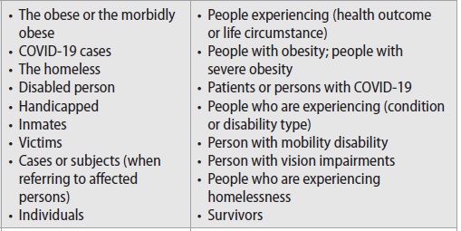
3. Focus on Positive Themes and Humanizing Details
“Person-first” language
Notes:
● Compliment and show approval. Providers can add compliments in EHR notes that spotlight the patient in a positive light or denote approvals

Slide 12
3. Focus on Positive Themes and Humanizing Details
Build a sense of abundance.
“This child is brilliant because…”
An asset list that is longer than a problem list.
Document strength-based approaches or co-identified solutions with family members
“Hakeem and his father have decided that joining a little league team would help Hakeem be more active.”
Notes:
● Compliment and show approval. Providers can add compliments in EHR notes that spotlight the patient in a positive light or denote approvals

Slide 13
3. Focus on Positive Themes and Humanizing Details
Minimize blame, labeling, and judgment.
“She is not tolerating oxygen” vs. “She is refusing to wear oxygen.”
“Workers who do not use PPE” vs. “People with limited access to (specific service/resource)”
“People who do not seek healthcare” vs. “Workers under-resourced with (specific service/resource)”
“She has not been checking her morning glucose for a month because she lost her blood glucose monitor”
Notes:
It is important to minimize blame on patients and avoid language that ascribes responsibility to patients for their conditions, opting for…instead of the judgmental.
Providers can also avoid judging situations that can happen to anyone or that might have valid explanations behind them.

Slide 14
3. Focus on Positive Themes and Humanizing Details
Case Study
Physicians who read a vignette with the term “substance abuser” compared with the term “having a substance use disorder” were more likely to agree that a fictionalized patient was to blame, punitive measures should be taken against the patient, and/or that the patient was not in need of medical treatment.
Notes:
(https://pubmed.ncbi.nlm.nih.gov/20005692/)

Slide 15
4. Learn to Recognize and Avoid Stigmatizing Language
Comparing neutral versus stigmatizing language through, say, chart note vignettes and reflection questions such as
What examples of stigmatizing language have you seen in EHR notes? What type of language could cast blame or reinforce stereotypes?
When reading EHR notes from other providers, what judgments have you made, if any, and was it connected to language that reflected frustrations or negative judgments from the provider?
What are opportunities to be more self-reflective with implicit or explicit biases and to encourage other providers to do the same? How would a patient feel to read EHR notes that you wrote?
Notes:
Reflections could be done as an individual, informally with colleagues and staff, or as part of a more formal anti-bias training session across an institution.
to help identify stigmatizing language and find options to replace it with neutral language.

Slide 16
4. Learn to Recognize and Avoid Stigmatizing Language Neutral Versus Stigmatizing Chart Note Vignettes
Notes:
Reflections could be done as an individual, informally with colleagues and staff, or as part of a more formal anti-bias training session across an institution

Slide 17
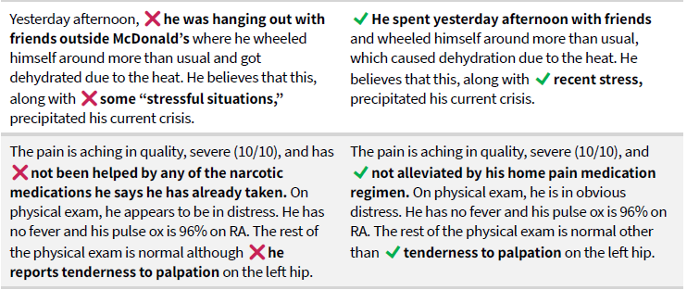
4. Learn to Recognize and Avoid Stigmatizing Language Neutral Versus Stigmatizing Chart Note Vignettes
Notes:
Reflections could be done as an individual, informally with colleagues and staff, or as part of a more formal anti-bias training session across an institution

Slide 18
4. Learn to Recognize and Avoid Stigmatizing Language Neutral Versus Stigmatizing Chart Note Vignettes
After 1 hour, the nurse documents: Mr. R is sleeping but easily arousable and ❌has been cussing at nurse. He refuses to wear his oxygen mask and is insisting that his pain is “still a 10.” His spouse is ❌on the bed with shoes on and requests a bus token to go home.
After 1 hour, the nurse documents: Mr. R is sleeping but easily arousable and seems distressed. He is not tolerating the oxygen mask and still has 10/10 pain. His spouse is by his side but will need to go home soon.
Notes:
Reflections could be done as an individual, informally with colleagues and staff, or as part of a more formal anti-bias training session across an institution

Slide 19
5. Educate Providers and Providers-in-training Neutral Versus Stigmatizing Chart Note Vignettes
Education is needed to recognize, avoid, and address implicit bias in health care settings by
Providing anti-bias workshops to reduce stigmatizing language that include reflection exercises, interactive role-plays, practiced perspective-taking, and mindful language tools;
Sharing resources and tools, including strategies to promote equity and dignity in clinical communications; preferred language when talking about addiction; and opportunities to build trust with patients;
Fostering case-specific discussions or person-first language simulations centered on word usage in medical school;
Teaching in the moment during clinical rotations; and
Asking for feedback and insights from patients and their families on how they are treated and the impact of language used during treatment and in EHRs
Notes:
As part of the initial and ongoing training of health care providers,
Perspective-taking is the ability to see the world from someone else's point of view, understanding their thoughts, feelings, and experiences as if they were your own. It's not just about knowing what someone else believes; it's about actively empathizing and stepping into their shoes.

Slide 20
SUMMARY
Following the recommendations will promote patient-centered care and dignity by:
trusting patients and avoiding communicating disbelief
being mindful when using quotes;
focusing on positive themes and humanizing details;
learning to recognize and avoid stigmatizing language; and
educating providers and providers-in-training.
Notes:
The Center for Health Care Strategies (CHCS)

Slide 21
THANK YOU
​
Rezaee.abdullah@ut.ac.ir
0915 720 4305

