Slide 1
Let’s DEBATE!
“Can Money Buy Happiness?
November 8, 2023

Slide 2
How to Conduct a Debate?
Introduce the topic of the debate.
Divide the participants into two groups. One for and one
Give the participants time to research and prepare their arguments.
For group presents their position (5 minutes).
Against group rebuttal (3 minutes).
Against group presents their position (5 minutes).
For group rebuttal.
Both groups question each other.
Closing statements.
Judgement, either by the judges

Slide 3
Some good debate rules
Speak politely to other participants and do not raise your voice.
Do not interrupt other participants when they are speaking.
Respect everyone’s opinion.
No idea is a stupid idea.
Keep to your allotted time.
Be open minded.

Slide 4
Money makes the world go round!

Slide 5
Money Talks!

Slide 6
Money is the root of all evil?

Slide 7
Will Earning a Great Salary Make me Happier?

Slide 8
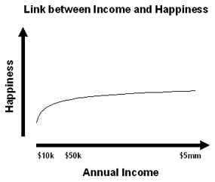
The difference in happiness between Americans who earn $50,000 and those that earn $10,000 per year is significant.
But the difference in happiness between Americans making $100,000 per year and $5 million per year is not significant.
This has been proven in countless scientific studies.
https://www.lifeevolver.com/false-belief-more-money-income-will-make-you-happier/

Slide 9
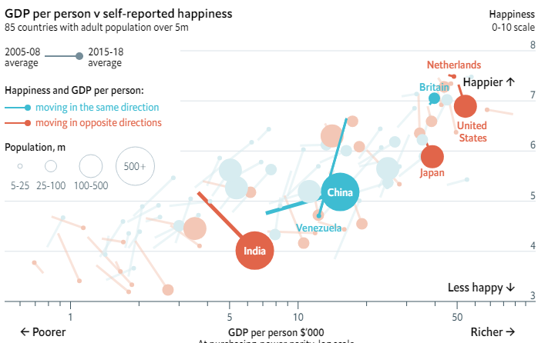
Economic growth does not guarantee rising happiness
https://www.economist.com/graphic-detail/2019/03/21/economic-growth-does-not-guarantee-rising-happiness

Slide 10
Acquisition Addiction
Glorification of consumerism is a vicious circle
Possession Paradox
We quickly get used to new possessions
We keep raising the bar (escalating the expectations)
The possessions come with comparisons

Slide 11
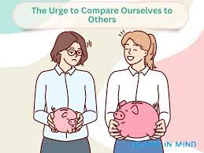
The Compulsion to Compare

Slide 12
